Slide 2
Administration

Slide 3
Administration
Body System (Character 2)
Contains three body system values
Physiological Systems and Anatomical Regions
Circulatory
Indwelling Device
Root Operation (Character 3)
Physiological Systems and Anatomical Regions
Introduction: Putting in a therapeutic, diagnostic, nutritional, physiological or prophylactic substance except blood or blood products
Irrigation: Putting in or on a cleansing substance
Circulatory System
Transfusion: Putting in blood or blood products

Slide 4
Administration
Body Part (Character 4)
For Introduction, the body part specifies where the procedure occurs and not necessarily the site where the substance introduced has an effect
For Irrigation, the body part specifies the site of the irrigation
Approach (Character 5)
Approach uses values defined in the Medical and Surgical section
The approach value for intradermal, subcutaneous and intramuscular introductions (i.e., injections) is percutaneous
If a catheter is used to introduce a substance into a site within the circulatory system, the approach value is also percutaneous
Substance
Substances are specified in broad categories
Substance values depend on body part

Slide 5
Administration
Physiological System & Anatomical Regions
Common Examples are :
Antineoplastic
Thrombolytic
Anti-infective Anti-inflammatory
Radioactive Substance
Nutritional Substance
Electrolytic and Water Balance Substance
Irrigating Substance
Dialysate
Local Anesthetic
Regional Anesthetic
Inhalation Anesthetic
Gas Contrast Agent

Slide 6
Administration
Circulatory System
Common Examples are :
Serum Albumin
Frozen Plasma
Fresh Plasma
Plasma Cryoprecipitate
Red Blood Cells
Stem Cells, Hematopoietic
White Cells
Platelets
Globulin
Fibrinogen
Factor IX
Bone Marrow

Slide 7
Administration
Qualifier - May further specify a substance
Common Examples are :
High-dose Interleukin-2
Liquid Brachytherapy Isotope
Insulin

Slide 8
Coding Clinic
What ICD-10-PCS procedure code should be assigned for a new drug or other therapeutic substance administered in the hospital inpatient setting to treat COVID-19 when there is no unique code for the administration of the specific substance
Answer:
XW013F5 Introduction of other new technology therapeutic substance into subcutaneous tissue, percutaneous approach, New Technology Group 5
XW033F5 Introduction of other new technology therapeutic substance into peripheral vein, percutaneous approach, New Technology Group 5
XW043F5 Introduction of other new technology therapeutic substance into central vein, percutaneous approach, New Technology Group 5
XW0DXF5 Introduction of other new technology therapeutic substance into mouth and pharynx, external approach, New Technology Group 5

Slide 9
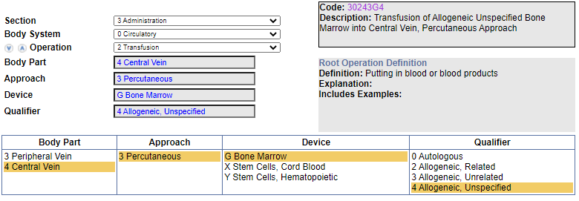
Clinical Examples
Procedure: Transplant, Bone Marrow
In a sterile environment, nonautologous bone marrow was delivered into the patient’s bloodstream through a central venous catheter.
Code Navigation:

Slide 10
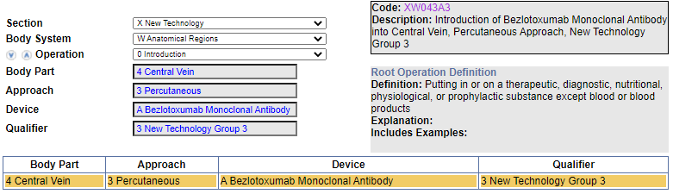
Clinical Examples
Infusion, Bezlotoxumab Monoclonal Antibody Via Central Vein
Code Navigation:

